Slide 1
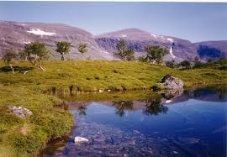
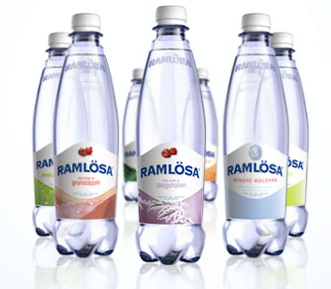
From water source to bottle
Water use in Sweden

Slide 2
Cleaning the water
Chemical purification
Mechanical purification
Biological purification

Slide 3
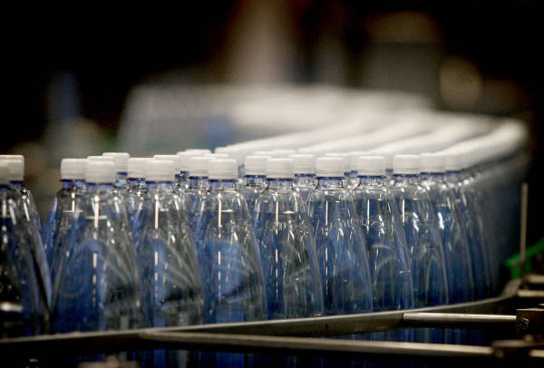
Producing and then filling the bottles

Slide 4
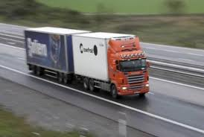
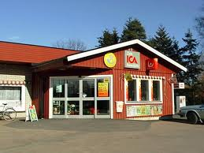
Delivery to the markets

Slide 5
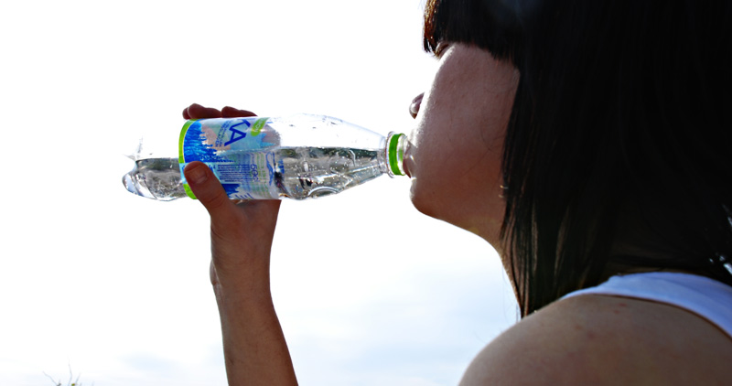
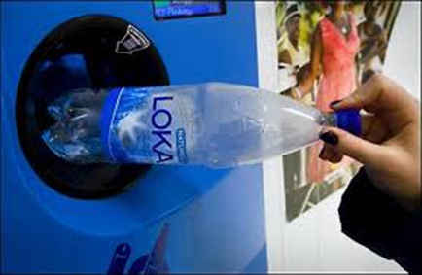
Enjoy!
Recycle
144 bottles /person
http://www.youtube.com/watch?v=4KbXz-eVRJY

Slide 6
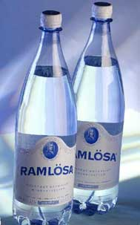
Vitamines per litre water
Sparkling
Sodium 210 mg
Calcium 3 mg
Potassium 2mg
Magnesium 0,5 mg
Bicarbonate 520 mg
Chloride 21 mg
Sulphat 6 mg
Flouride 2,7 mg
Still
Ca 80 mg
Mg 26 mg
Na 6,5 mg
K 1mg
Sio 15 mg
Hco 360 mg
So 12,6 mg
C 6,8 mg
No 3,7 mg

Slide 7
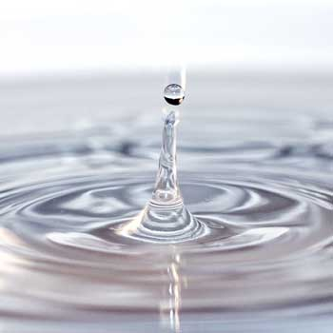
Water use per person and day
180-200 litres per day per person
- Hygiene 65 l
- Flushing toilet 35 l
- Washing 25 l
- Food + drink 10 l
- The rest 10 l

